Slide 1
Team Leada – Mighty Hive
By – Sachin Kant Misra

Slide 2
Prepared Files used for Model

Slide 3
Linear Regression
NULL HYPOTHESIS: THERE IS NO SIGNIFICANT RELATIONSHIP BETWEEN OUTCOME AND TEST_VARIABLE i.e. H0 : μ1 - μ2 = 0
ALTERNATE HYPOTHESIS: THERE IS A SIGNIFICANT RELATIONSHIP BETWEEN OUTCOME AND TEST_VARIABLE i.e. Ha :μ1 - μ2 ≠ 0 >
clean_dataset <- read.csv("MightyHive Cleaned Data.csv", header = T, stringsAsFactors = FALSE)
> clean_dataset$Test_Variable <- ifelse(clean_dataset$Test_Variable=="test",1,0)
> clean_dataset$Outcome <- ifelse(clean_dataset$Outcome=="BUY",1,0)
> lm_clean_dataset <- lm(Outcome~Test_Variable)
> summary(lm_clean_dataset)

Slide 4
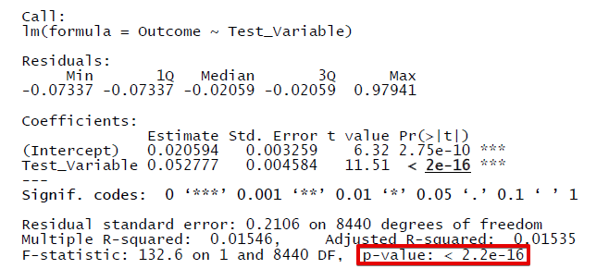
Outcome
As the p-value is much less than 0.05, we reject the null hypothesis that β(beta) = 0. Hence there is a significant relationship between the variables in the linear regression model for Outcome and Test_variable.

Slide 5
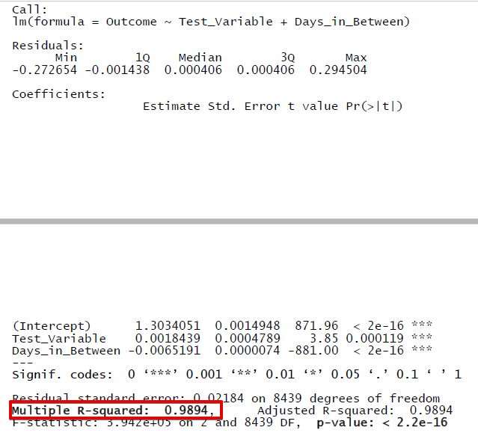
Model considering Days in Between call
As the p-value (for all data variables) is much less than 0.05, we reject the null hypothesis that β0, β1 = 0 and our alternate hypothesis is TRUE. Hence there is a significant relationship between the variables in the linear regression model for Outcome and Test_variable, Days_in_Between.
Also, The Adjusted R-Squared ~ 99% which indicates the regression model is highly significant for prediction when Time response is included as data value.

Slide 6
Conclusion
Re-Targeting does help business to attract and sell products to more number of customers.

